Slide 1


Slide 2


VoicePay-Easy UPI for Everyone
Second Year
Submitted by
ROLL | NAME
2501730425 | Sanchita Saroj
2501730440 | Rohit Kushwaha
2501730439 | Kevin Gautam Shah
2501730500 | Khushi Singh
2501730328 | Manas Kumar Shaw
Faculty Mentor: Himanshi Yadav
Notes:
New Courses replaced with New Programmes

Slide 3

Problem Statement & Community Context
Problem Statement
India has witnessed rapid growth in digital payments through UPI. However, many elderly citizens and low-literacy users struggle to use these services independently due to complex interfaces, unfamiliar banking terminology, and fear of making mistakes during transactions.
As a result, many users remain dependent on family members or others for digital payments, increasing their vulnerability to financial fraud and limiting financial inclusion.
Community Context
• Many elderly users find smartphone interfaces and banking terminology difficult to understand.
• Low-literacy individuals often struggle to read instructions, verify payment details, and understand transaction messages.
• Fear of making mistakes or sending money to the wrong person discourages independent use of digital payment apps.
• Dependence on family members or others for digital transactions reduces financial independence and privacy.
• Limited awareness of online frauds, phishing, and fake payment requests increases security risks.
Notes:
New Courses replaced with New Programmes

Slide 4
Specific Objectives of Project /
Requirements of Organization
Objectives
• Help elderly and low-literacy users use UPI services with confidence.
• Provide simple voice-guided support for digital payment tasks.
• Guide users through payment-related steps.
• Reduce confusion and dependence on others for everyday digital transactions.
• Increase awareness of safe and secure digital payment practices.
• Help user identify common payment scams and risks.
Requirements of the Organisation (Local NGO)
• Help people learn how to use UPI.
• Voice-based guidance for common UPI activities.
• Teach users how to stay safe from online fraud.
• Make digital payments easier to understand.
• Provide simple guidance when they face difficulties.
Notes:
New Courses replaced with New Programmes

Slide 5
SDG Mapping & Justification
SDG 1 – No Poverty
VoicePay promotes financial inclusion by helping elderly and low-literacy users access and use digital payment services independently. Easy access to digital transactions can improve participation in financial systems and reduce reliance on cash-based processes.
SDG 10 – Reduced Inequalities
The project addresses barriers faced by digitally challenged users by providing simple voice-guided assistance. It helps bridge the gap between technology and vulnerable populations, ensuring more equitable access to digital financial services.
Justification
Many elderly and low-literacy individuals are unable to fully benefit from digital banking due to usability and accessibility challenges. VoicePay reduces these barriers through voice-based guidance, enabling users to perform UPI transactions with greater confidence, independence, and safety. By improving accessibility and financial inclusion, the project directly contributes to SDG 1 and SDG 10.
Notes:
New Courses replaced with New Programmes

Slide 6
Methodology and Tech Stack
Methodology
Requirement Analysis – Identify challenges faced by elderly and low-literacy users while using UPI services.
System Design – Design a simple and accessible voice-guided user interface.
Development – Build the application and integrate voice assistance features.
Testing & Feedback – Conduct usability testing and collect feedback from target users.
Improvement & Deployment – Refine the system based on feedback and prepare the final solution.
Tech Stack
Frontend: React.js
Backend: Python
Database: Firebase
Voice Technologies: Speech-to-Text API & Text-to-Speech API
Development Tools: GitHub, VS Code & Figma (UI Design)
Notes:
New Courses replaced with New Programmes

Slide 7
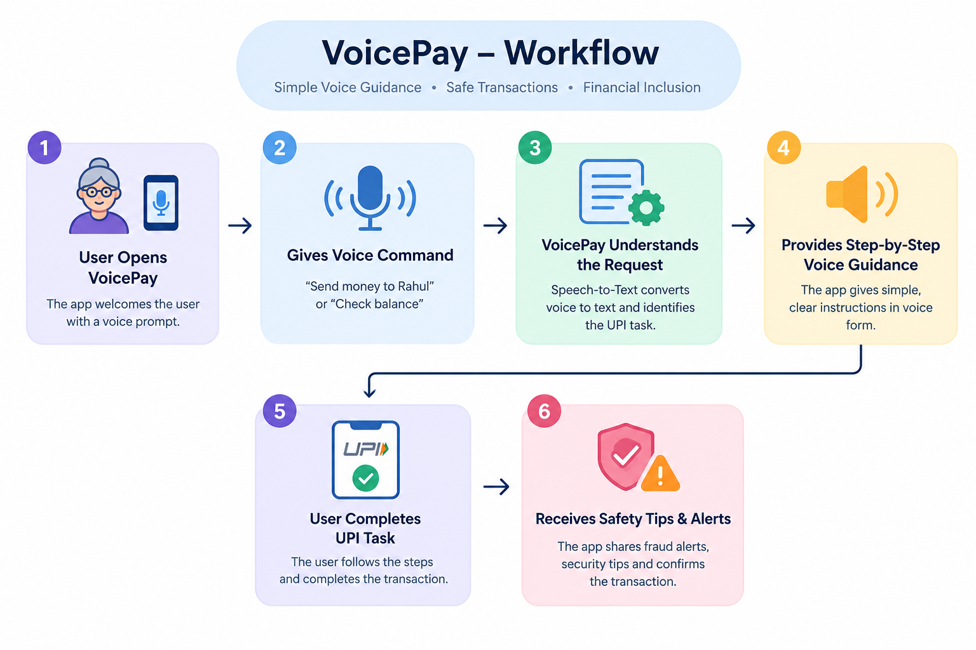

Prototype/Project Flow diagram/Architecture
#Architecture
User
↓
React.js Interface
↓
Voice Processing
↓
Node.js Backend
↓
Firebase Database
Notes:
New Courses replaced with New Programmes

Slide 8
Project Timeline (Semester Plan)
Weeks 1–2: Problem Identification & Community Research
Understand the challenges faced by elderly and low-literacy users while using UPI services.
Week 3: Requirement Analysis & NGO Consultation
Identify user needs and gather requirements for the proposed solution.
Weeks 4–5: System Design & UI Planning
Design a simple, accessible interface and define the voice-guided workflow.
Weeks 6–9: Development & Voice Integration
Develop the application and integrate Speech-to-Text and Text-to-Speech features.
Weeks 10–11: Backend & Database Integration
Configure Firebase services and connect all system components.
Weeks 12–13: Testing & User Feedback
Test the application, identify issues, and incorporate user feedback.
Week 14: Documentation & Report Preparation
Prepare project documentation, reports, and presentation materials.
Week 15: Final Review & Submission
Conduct final testing, demonstrate the project, and complete submission.
Notes:
New Courses replaced with New Programmes

Slide 9
Data & Resources (if any)
Data Sources
• Feedback collected from elderly users and individuals with limited digital literacy.
• Discussions with the collaborating NGO to understand community challenges.
• RBI and NPCI guidelines on digital payments and UPI safety.
• Research on common digital payment frauds and user difficulties.
Resources Used
• React.js and Node.js Documentation
• Firebase Services
• Speech-to-Text and Text-to-Speech APIs
• Digital Payment Awareness Resources
Notes:
New Courses replaced with New Programmes

Slide 10
Project Use cases & Scope
Project Use Cases
Voice-Guided Payment Assistance
Provides step-by-step voice instructions to help users perform UPI transactions confidently.
Understanding UPI Prompts
Explains payment requests, transaction messages, and banking terms in simple language.
Digital Safety Awareness
Alerts users about common payment scams and promotes safe digital payment practices.
Support for First-Time Users
Assists users who are new to digital payments and need guidance while using UPI services.
Project Scope
VoicePay is designed for elderly citizens, low-literacy individuals, and first-time digital payment users who face difficulties using UPI applications. The solution can be used in community digital literacy programs and NGO-led initiatives to improve financial inclusion, digital confidence, and safe adoption of digital payment services.
Notes:
New Courses replaced with New Programmes

Slide 11
Expected Results & Impact
Expected Outcome
VoicePay will help elderly and low-literacy users understand and perform basic UPI transactions through simple voice-guided assistance. Users will be able to follow payment instructions more easily, understand common UPI prompts, and learn essential digital payment safety practices with reduced dependence on others.
Impact
VoicePay can make digital payments more accessible and less intimidating for elderly and low-literacy individuals. By simplifying the payment process and promoting awareness of common online frauds, the project can improve users' confidence, independence, and participation in the digital economy.
Notes:
New Courses replaced with New Programmes

Slide 12
THANK YOU

